Slide 1
Convective Evaporation of a Water–Acetone Droplet

Slide 2
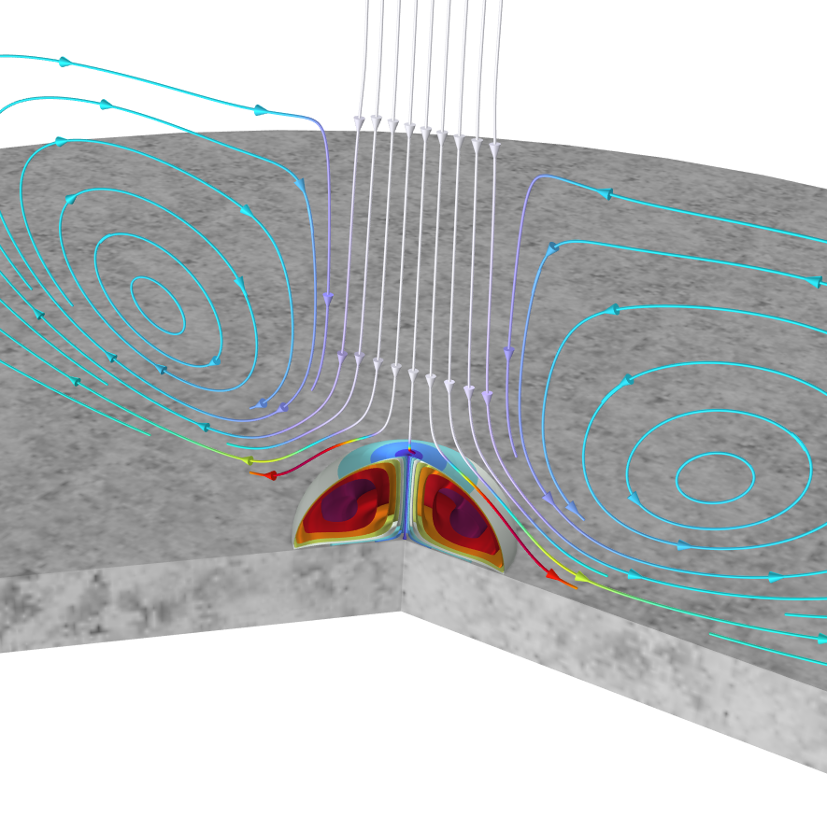
Background and Purpose
A liquid droplet is placed on a marble substrate. The droplet is a concentrated solution of water and acetone. Both the water and the acetone evaporate into the surrounding gas phase, causing it to shrink. The droplet is subjected to an impinging gas phase jet from above, which accelerates the evaporation by transporting vapor species away from the droplet surface. As it evaporates, the droplet is cooled due to the latent heat of evaporation.
This application shows how to model multispecies evaporation by combining functionality for vapor–liquid equilibria, fluid flow, heat transfer, and moving mesh.

Slide 3
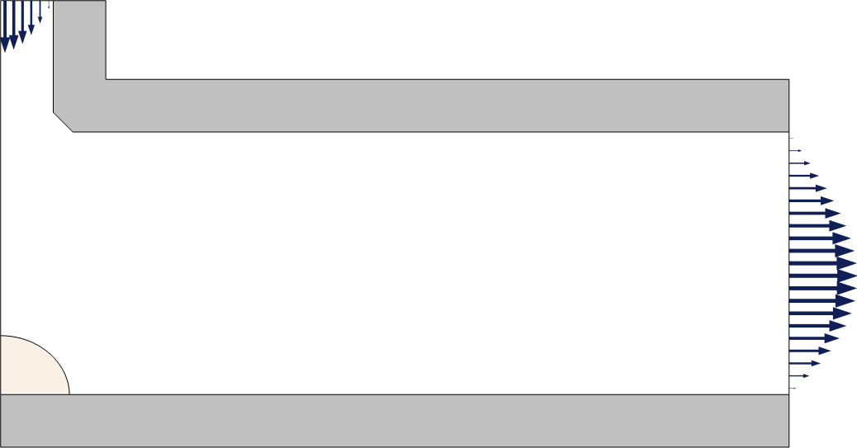

Model Setup
Geometry, domains, and boundary conditions
Inlet
Vapor domain
Solid (acrylic plastic)
Rel. humidity, $φ_{w}=$ 0.3
$T=25$°C
Outlet
Symmetry line
Vapor–liquid Interface
Solid (marble)
Droplet
20% acetone, 80% water

Slide 4
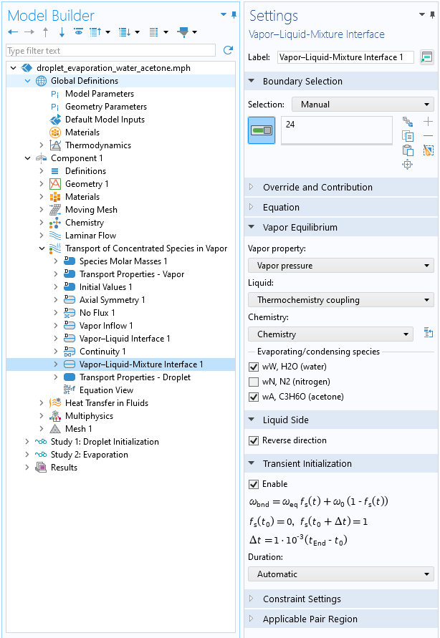
Vapor–Liquid-Mixture Interface Feature
Boundary Feature
Interface Transfer
Defines equilibrium vapor conditions at vapor–liquid interfaces
Applied on boundaries adjacent to a liquid domain
Supports water or concentrated liquid solutions
Vapor pressure dependent on T, p, and droplet composition
Vapor pressures prescribed
Evaporation or condensation when the ambient vapor conditions differ from the interface conditions
Resulting mass transfer and latent heat computed
Combine with moving mesh to solve for the resulting interface motion
Notes:
New in 6.2

Slide 5
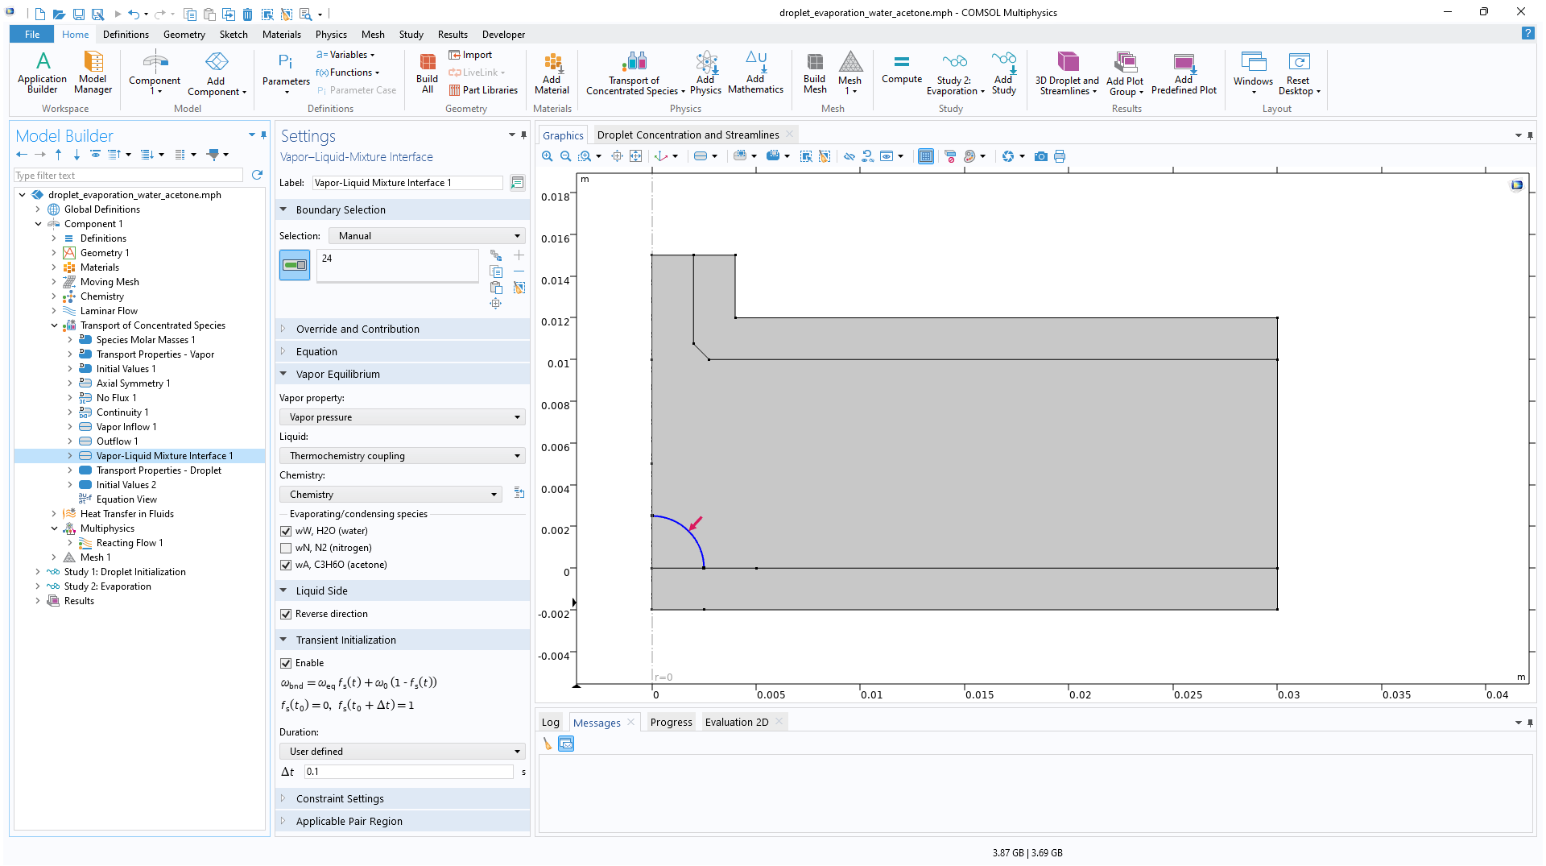
Vapor–Liquid-Mixture Interface Feature Conditions
Select Thermochemistry coupling to use automatically defined vapor pressure functions.
Identify a Chemistry interface coupled to a thermodynamic system.
Select the species that are able to evaporate or condense.
If needed, select Reverse direction for the arrow in the Graphics window to identify the liquid side of the interface.
1
2
3
4

Slide 6
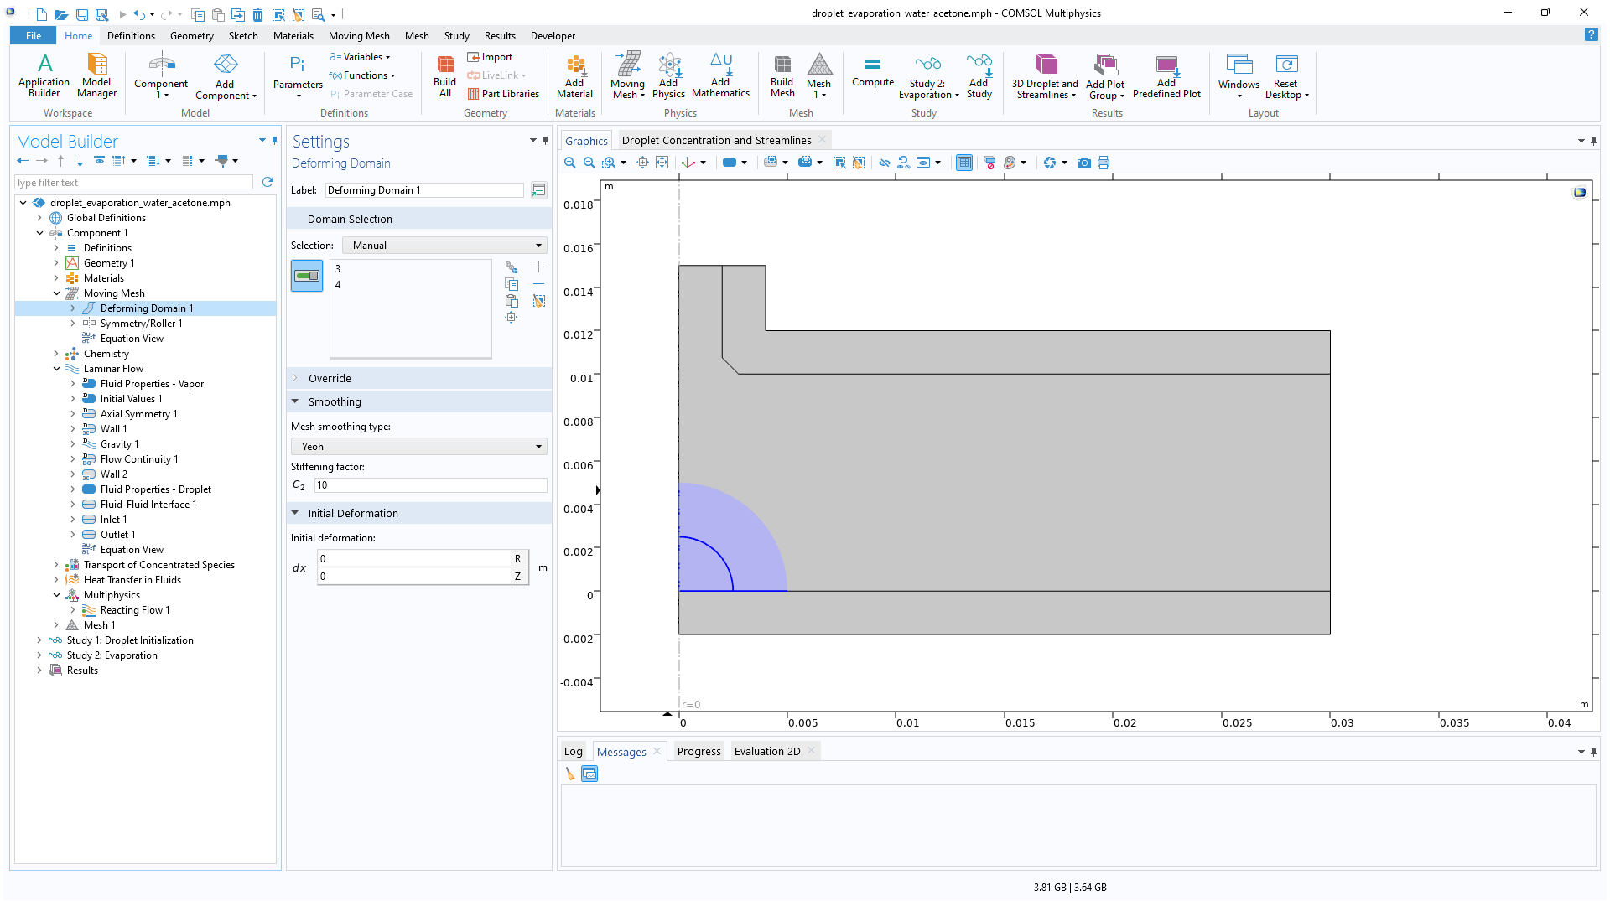
Droplet Surface Movement
1
Use a Moving Mesh with freely deforming domains adjacent to the droplet surface.
Add a Fluid-Fluid Interface node to the fluid flow interface.
Select the computed Evaporative mass flux. This is the net mass flux due to the evaporation, which drives the motion of the interface.
Select Reverse normal direction to make sure that the normal direction points to the liquid side.

Slide 7
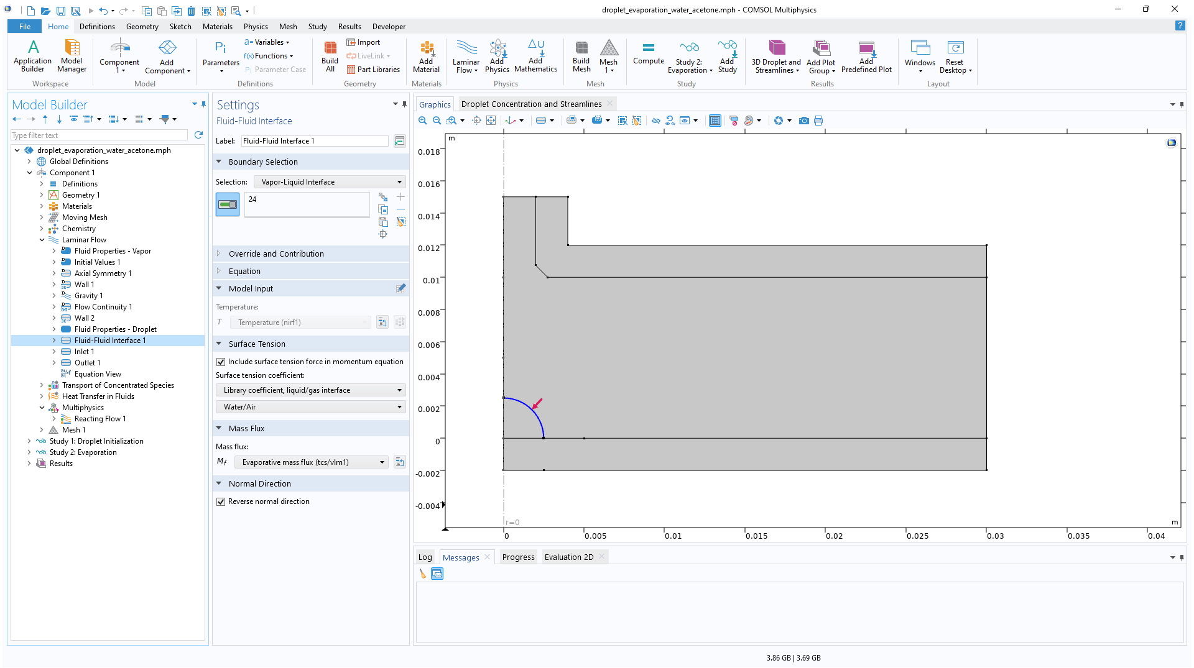
Droplet Surface Movement
Use a Moving Mesh with freely deforming domains adjacent to the droplet surface.
Add a Fluid-Fluid Interface node to the fluid flow interface.
Select the computed Evaporative mass flux. This is the net mass flux due to the evaporation, which drives the motion of the interface.
Select Reverse normal direction to make sure that the normal direction points to the liquid side.
2
3
4

Slide 8
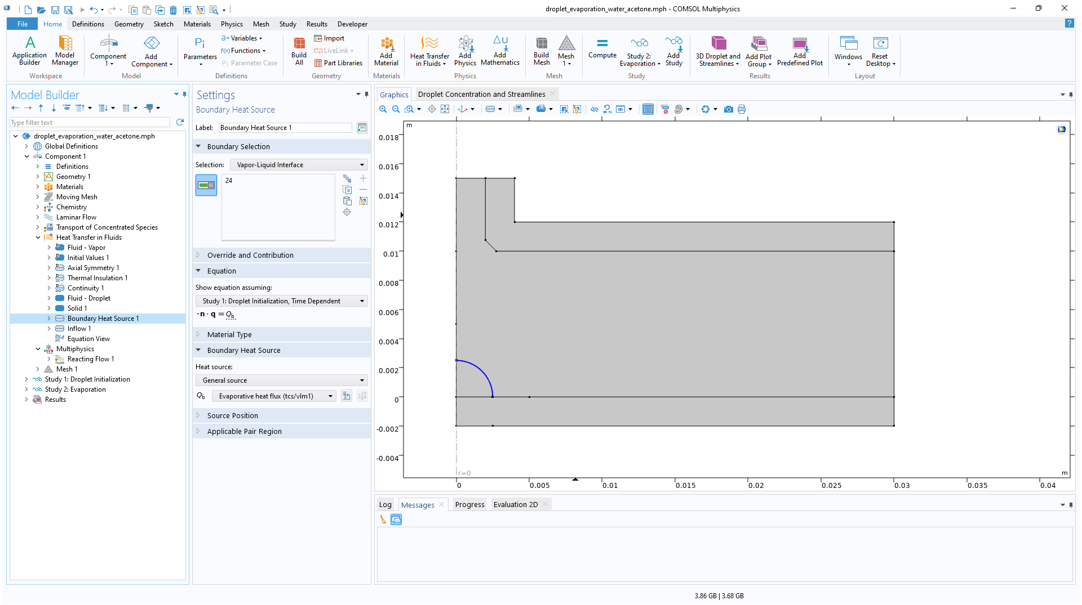
Latent Heat of Evaporation
Add a Boundary Heat Source feature to the heat transfer interface and apply it to the droplet surface.
Select the computed Evaporative heat flux. This corresponds to the latent heat of evaporation.
  Note that the button next to the drop-down list can be use to navigate to the node that computes the heat flux.
1
2

Slide 9
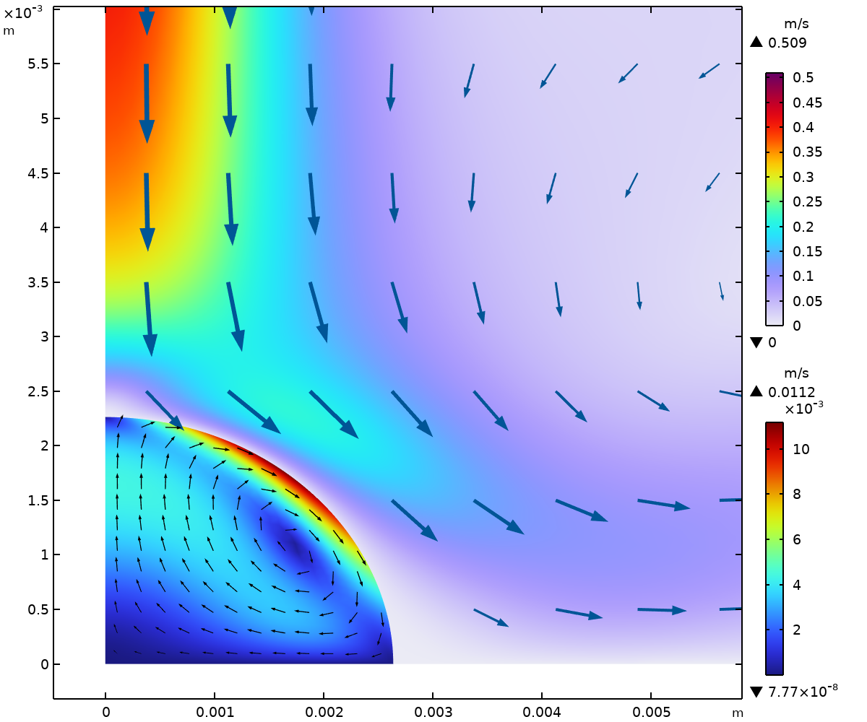
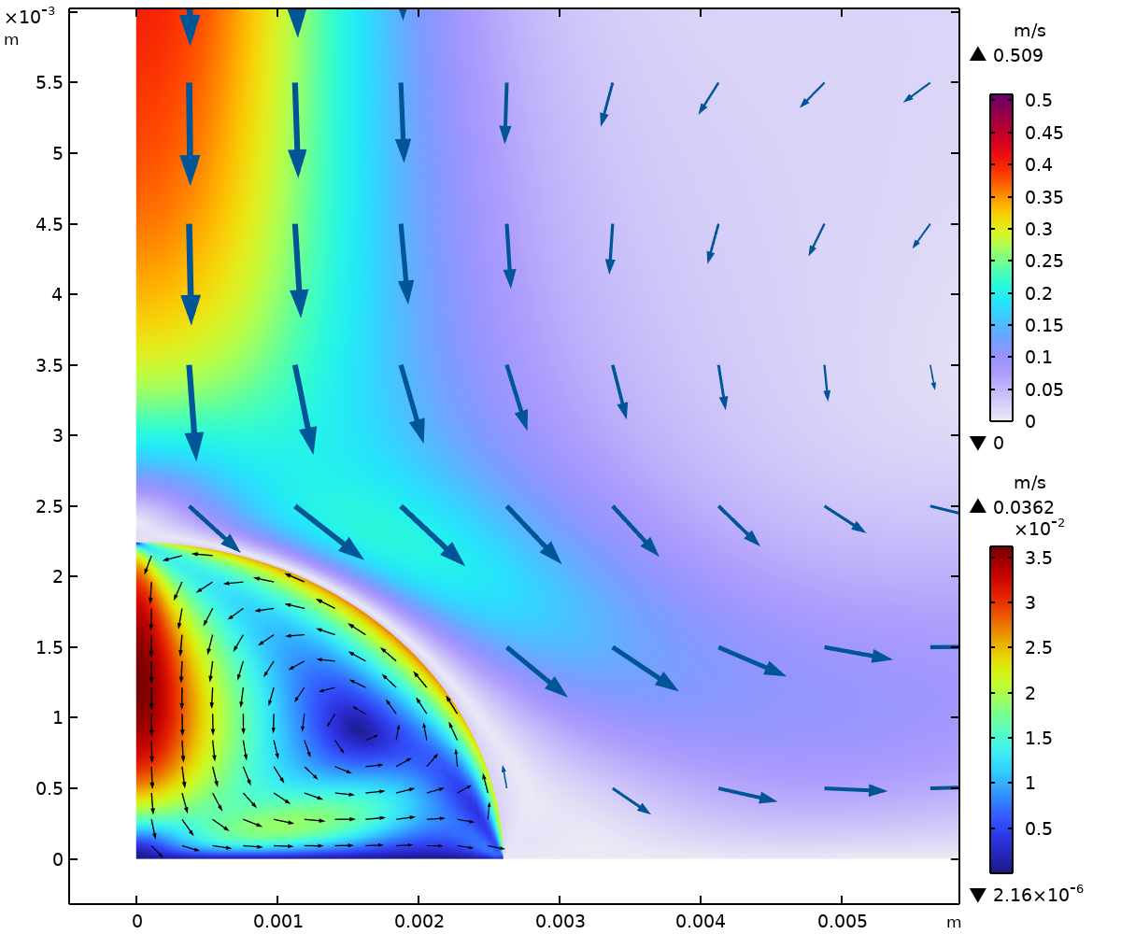
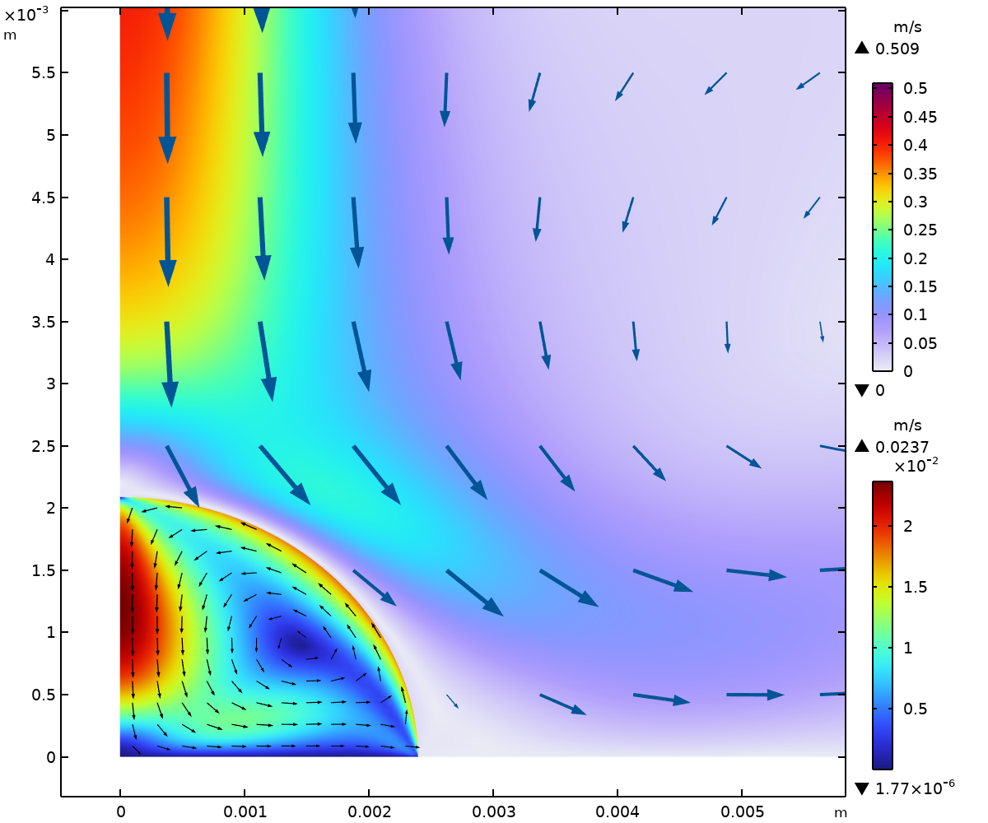
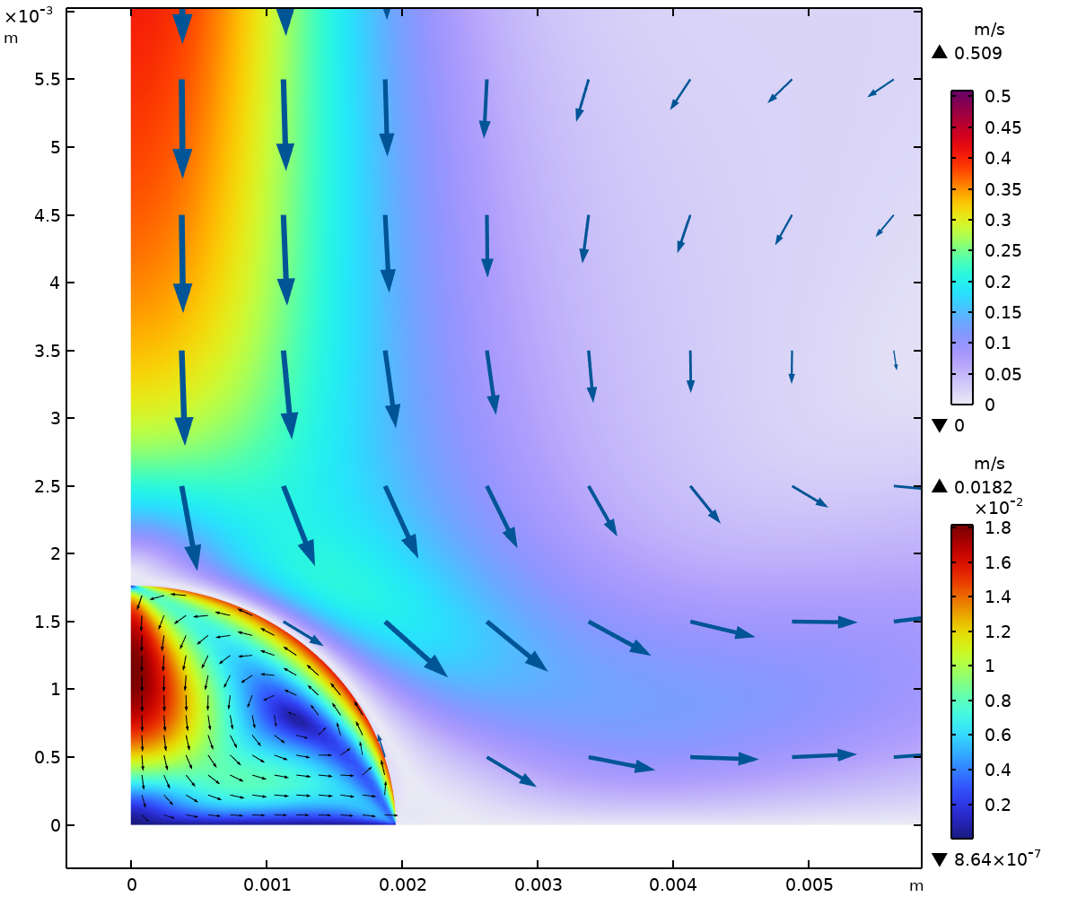
Fluid Flow in the Vapor and Droplet
Fluid flow both in the surrounding vapor and the liquid droplet
Nonspherical droplet due to gravity and surface tension
Droplet liquid velocity driven by buoyancy due to temperature and compostion variations
Evaporation from the droplet causes it to shrink
Velocity in the vapor and the droplet at t = 0 s (upper left), t = 10 s (upper right), t = 100 s (lower left), and t = 1000 s (lower right).

Slide 10
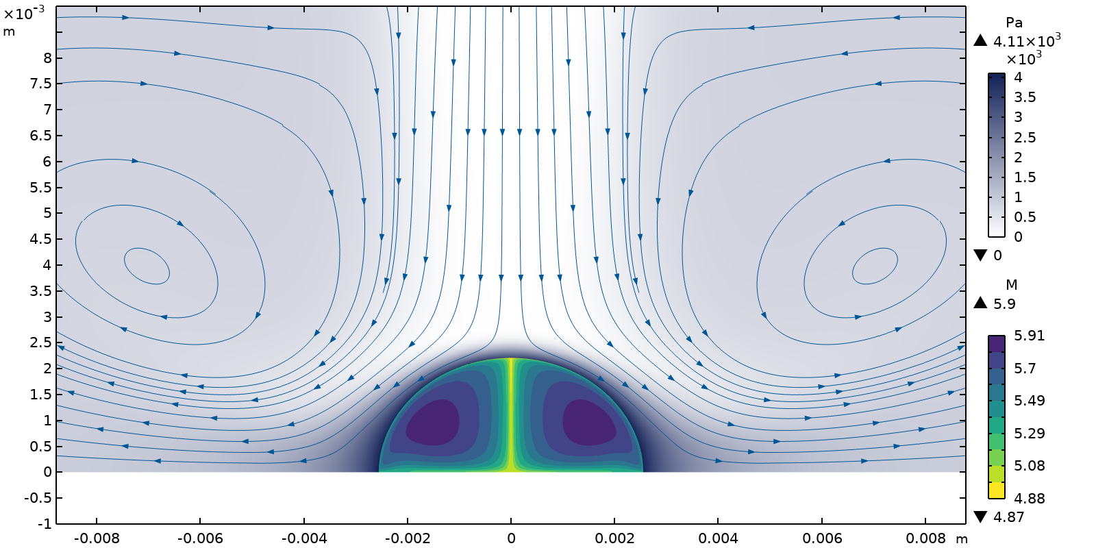
Acetone
Vapor
The vapor pressure just outside of the droplet surface is high, causing a fast evaporation of acetone.
Eventually the droplet contains only water.
Droplet
The concentration close to the surface is lowered by the phase transfer.
Diffusion is low in the liquid phase, causing sharper gradients.

Slide 11
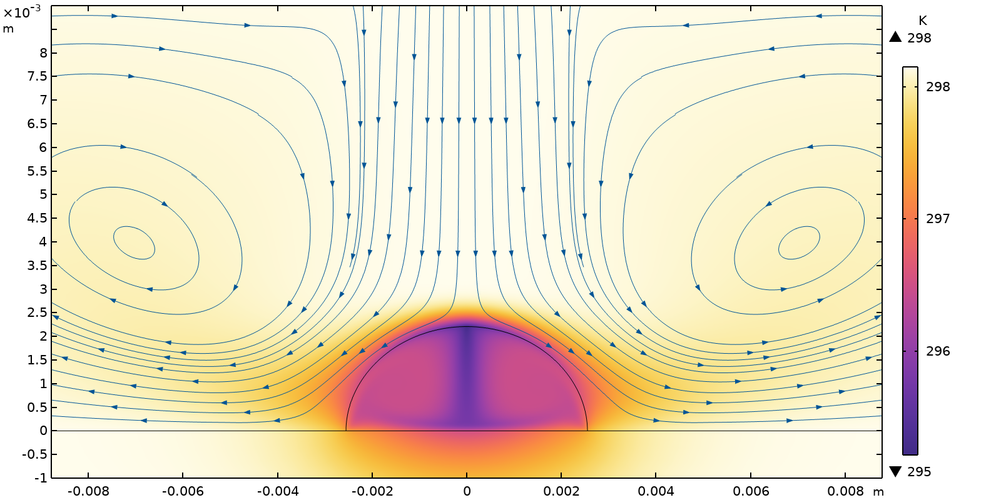
Temperature
Vapor
The vapor pressure just outside of the droplet surface is high, causing a fast evaporation of acetone.
Eventually the droplet contains only water.
Droplet
The concentration close to the surface is lowered by the phase transfer.
Diffusion is low in the liquid phase, causing sharper gradients.

Slide 12
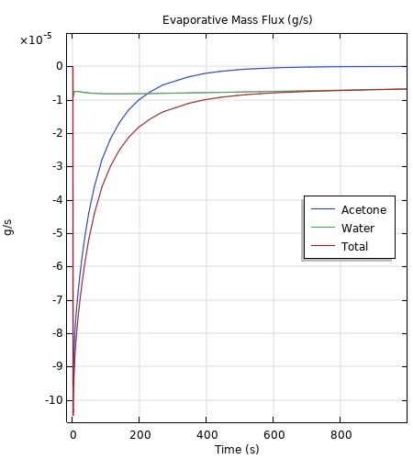
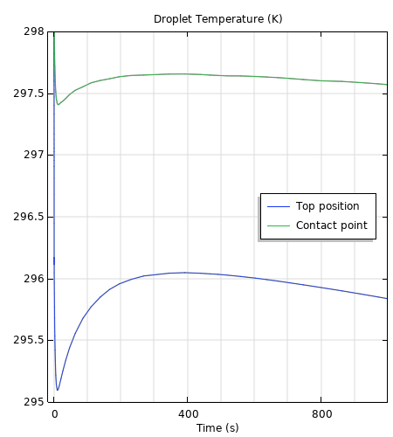
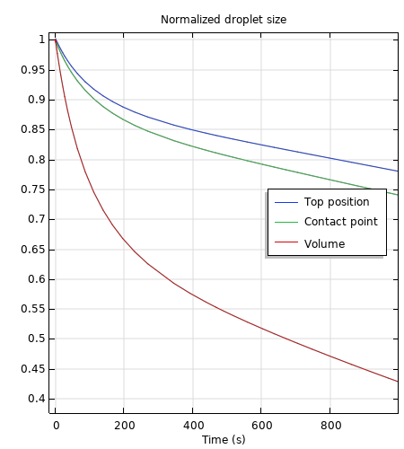
Droplet Evaporation
Fast evaporation of acetone is accompanied by a sharp reduction in droplet size and temperature. As the droplet is depleted of acetone, the temperature rises before it settles into evaporation of water only.

Slide 13
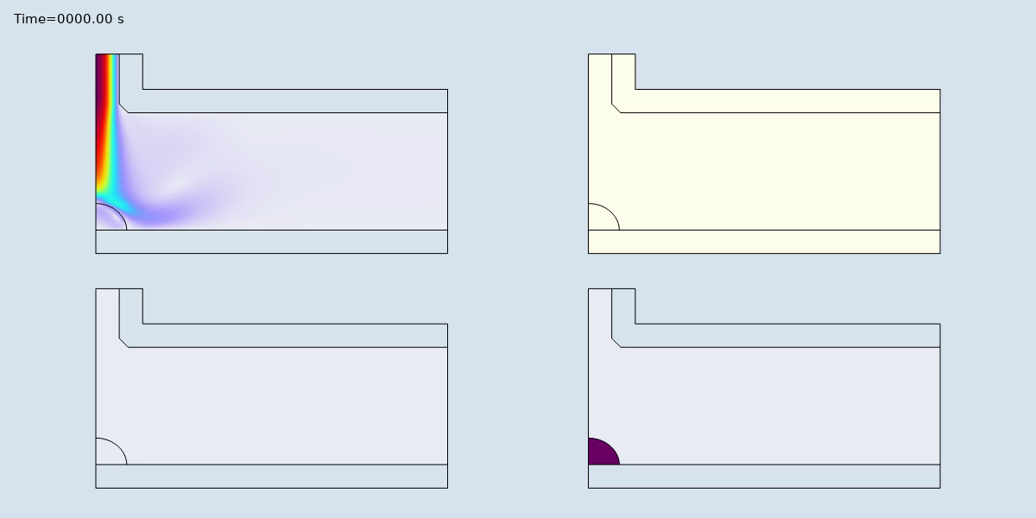
Droplet Evaporation
Velocity
Temperature
Acetone Concentration
Water Concentration
Vapor and droplet conditions at all stored time steps.

